Slide 1

QTM 151 Final Project
Rex Zhang, Chris Pei, Zach Cheng

Slide 2
TABLE OF CONTENTS
01
Introduction
03
Results
02
Methods
04
Discussion
Importance, research question, rationales, hypotheses
Data analysis, tables, plots
Dataset, variables, recoding
Findings, conclusion

Slide 3

01
Introduction

Slide 4
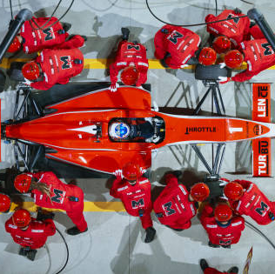
Why do pit stops matter?
What is a pit stop?
“A pit stop is a pause for refuelling, new tires, repairs, mechanical adjustments, a driver change, as a penalty, or any combination of the above.”
Why are they important?
Tire changes, refueling, etc
Repairs or track optimizations
Penalties
Main takeaway: Pit stops and their associated strategies are essential for a race team’s success. Therefore, the decision to take a pit stop, and how long is spent stopped, is crucial to a team’s performance.

Slide 5
Research Question:
Does taking shorter and fewer pit stops increase performance (measured by points and win rate)?

Slide 6
Hypothesis and Rationale:
Taking shorter and fewer pit stops increases driver performance by increasing time spent on the track and thus scoring more points.

Slide 7
02
Methods

Slide 8
pit_stops Table
driverid
duration
stops
wins
driver_standings Table
driverid
points
wins
Unique driver ID
Average duration of a pit stop for a race
Number of stops for a race
Number of wins for a race
Unique driver ID
Points accumulated by a driver for a race
Wins by a driver for a race

Slide 9
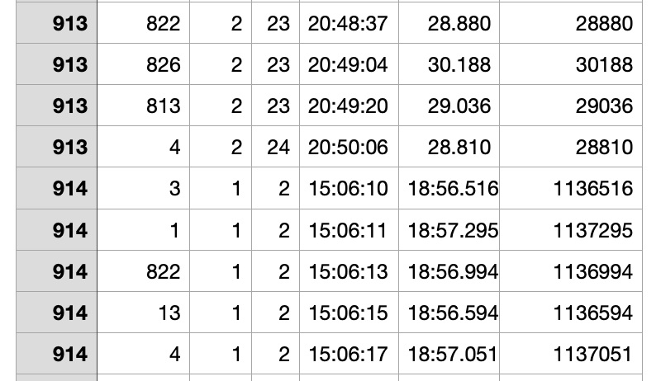
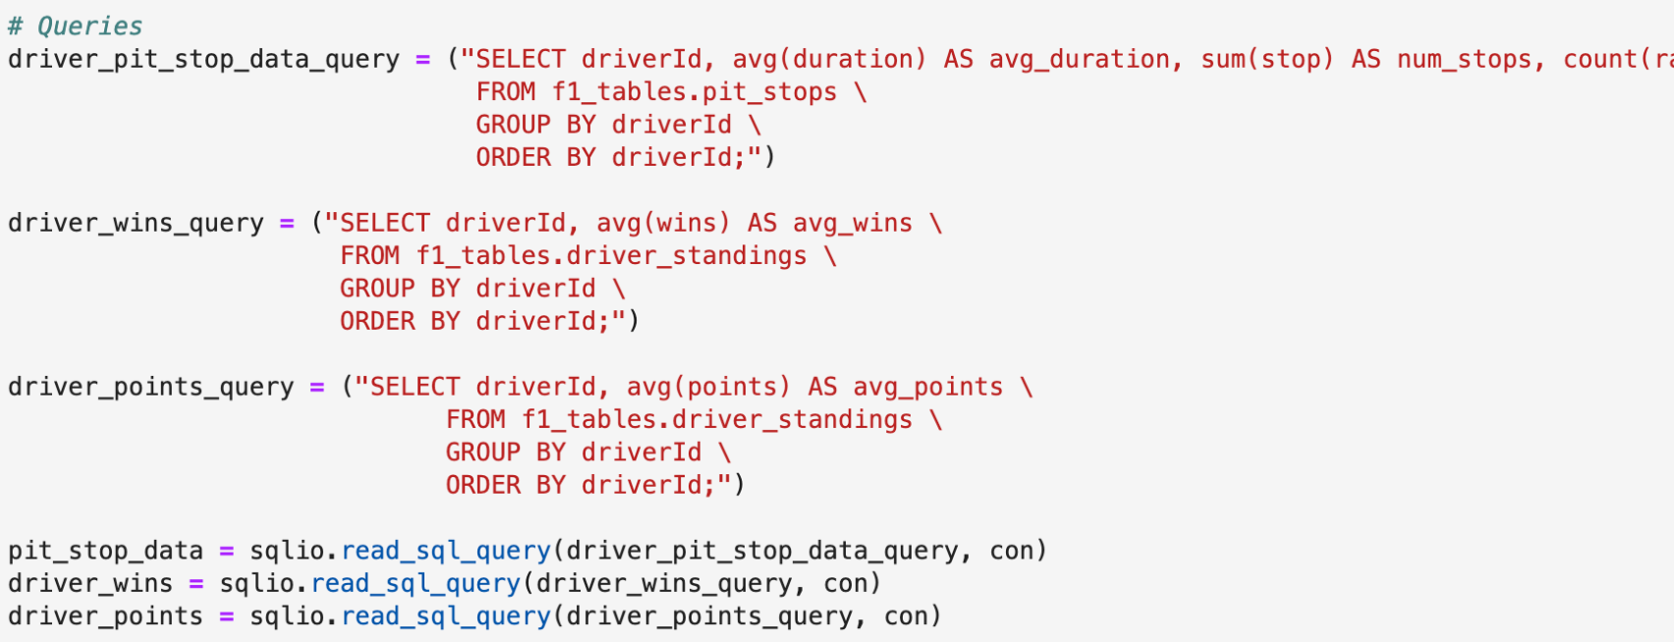
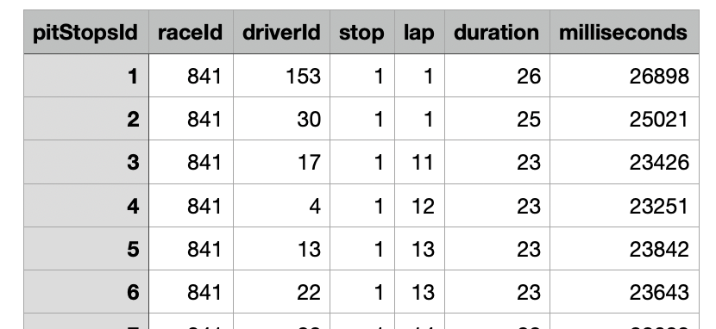
Data Cleaning, SQL, New Variables

Slide 10
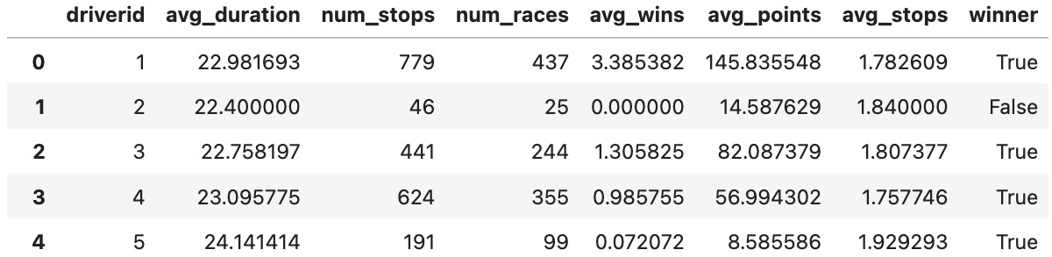
Final Data Frame

Slide 11
03
Results

Slide 12
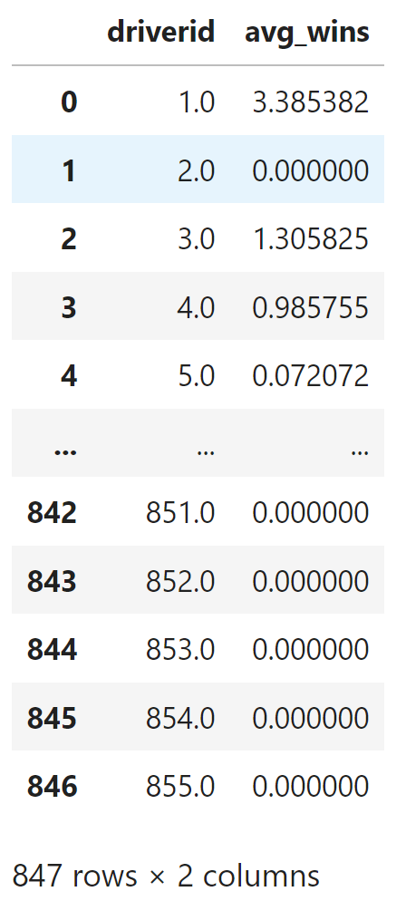
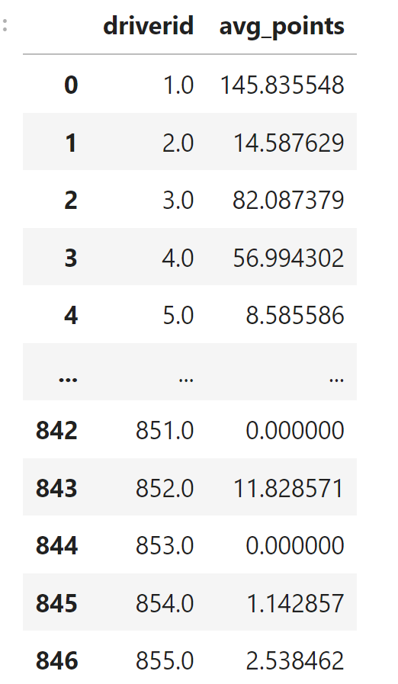
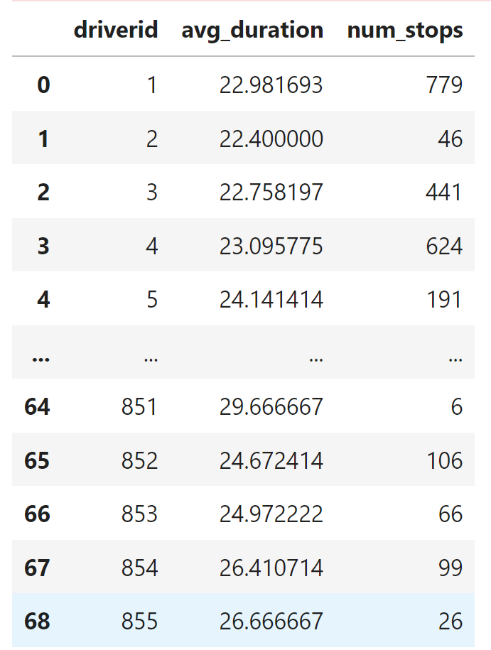
Tables

Slide 13
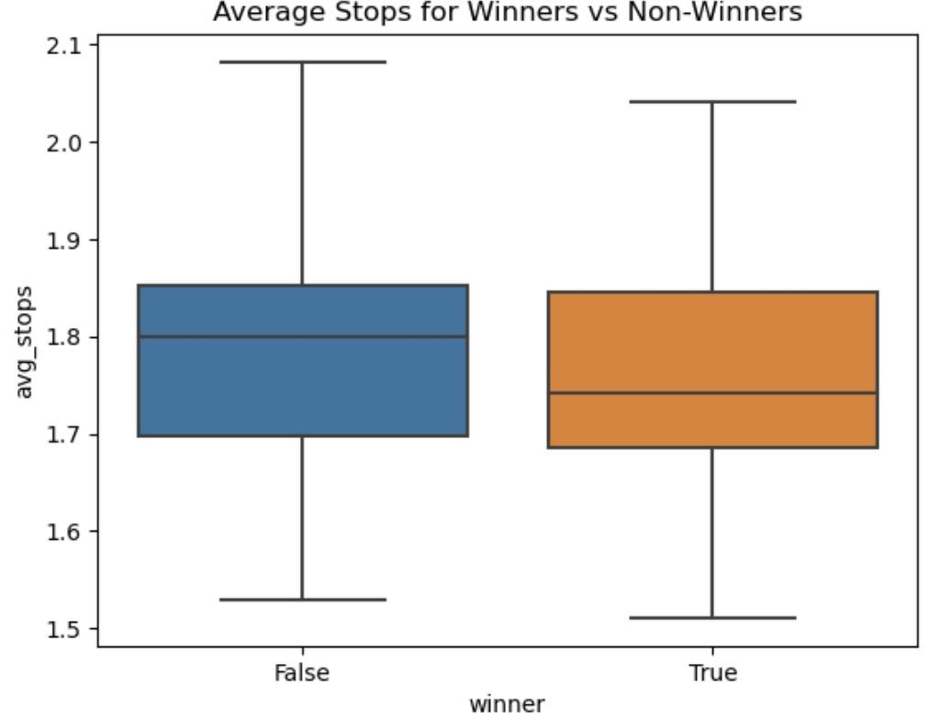
Graph 1
X axis: Winner or not (At least one win recorded)
Y axis: Average # of Stops
Result: Winners tended to have less stops on avg compared to non-winners

Slide 14
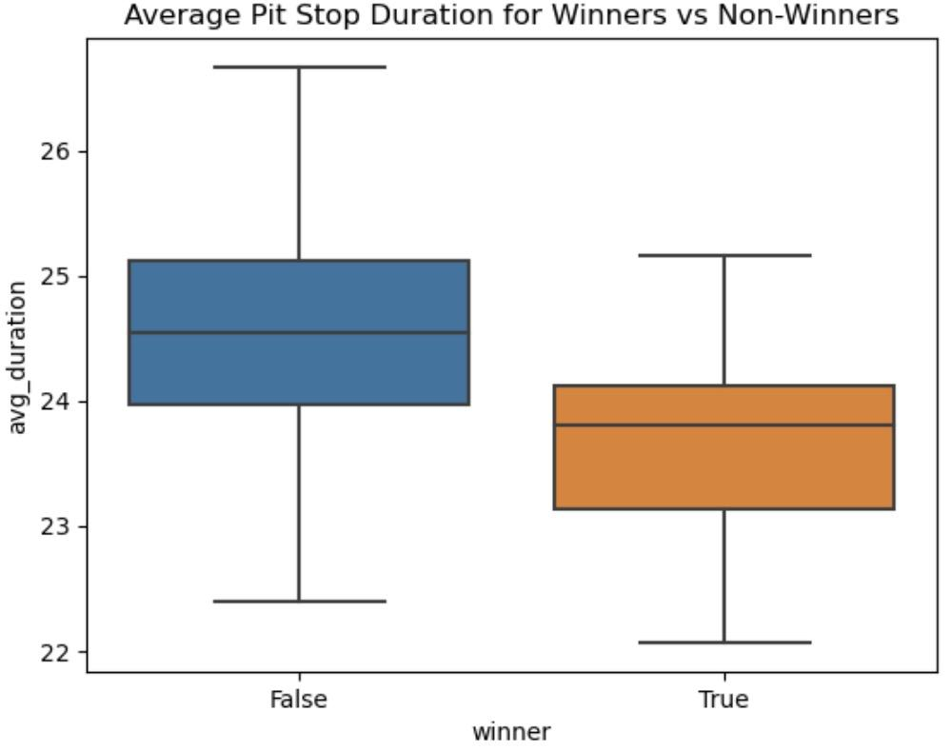
Graph 2
X axis: Winner or not (At least one win recorded)
Y axis: Average Duration time (sec)
Result: Winners tended to have a lower time spent per pit stop compared to non-winners

Slide 15
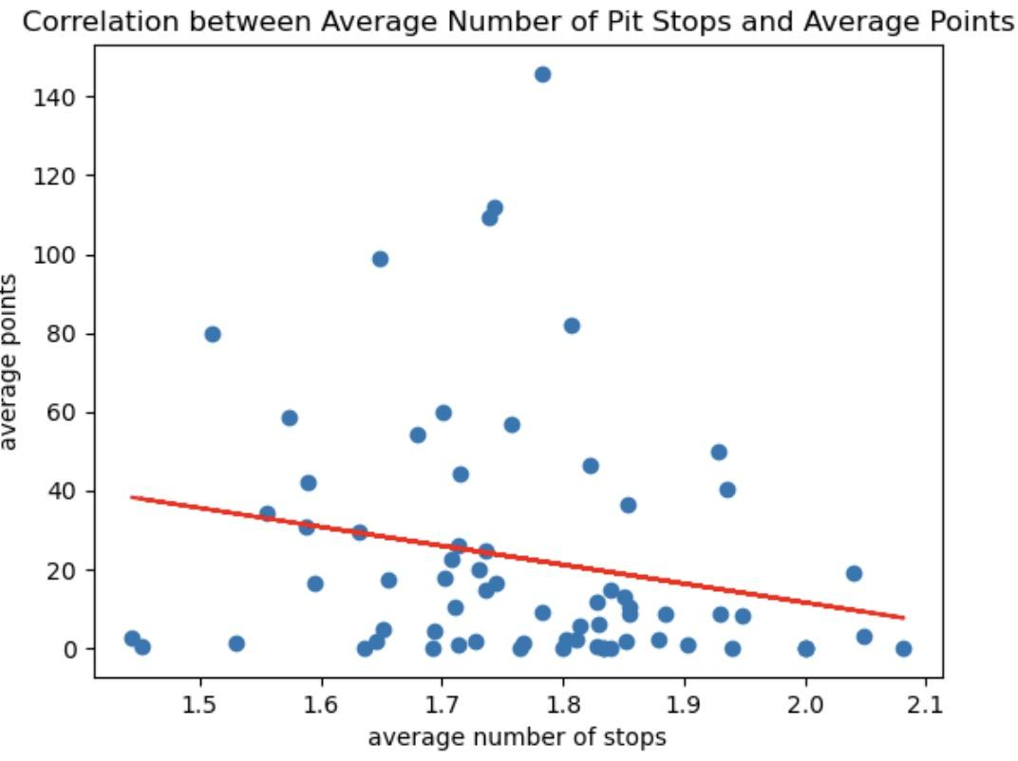
Graph 3
X axis: Average number of stops
Y axis: Average Points
Result:
Moderate negative correlation

Slide 16
04
Discussion

Slide 17
Conclusion
Given the previously provided graphs, we can see a clear negative correlation between average points and average number of stops. Our box plots also show that winners tend to take fewer pit stops than non-winners, as well as spending less time per pit stop than non-winners.
Our study has a few limitations. When cleaning the data for pit stops and examining the variables duration and stops, we chose to exclude data points that were not able to be imported into SQL. This amounted to about ~200 data points out of 8,000. This set of excluded data, while small, could have introduced data that pointed in alternative directions when compared to the data that we did keep.

